Slide 1



BRAZILIAN NATIONAL INSTITUTE FOR SPACE RESEARCH
POST-GRADUATE PROGRAM IN APPLIED COMPUTING
SEVERITY IDENTIFICATION IN MESOSCALE CONVECTIVE SYSTEMS USING RECURRENT AND CONVOLUTIONAL NEURAL NETWORKS
Work presented as a requirement for the CAP- 351 Neuro Computing course taught by Dr. Marcos G. Quiles
Adriano Pereira Almeida
Advised by Alan James Peixoto Calheiros

Slide 2

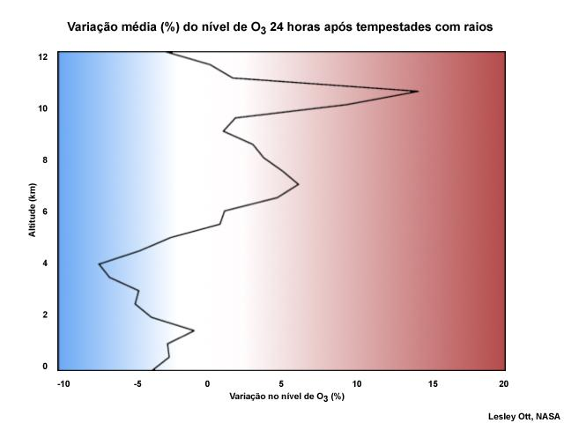
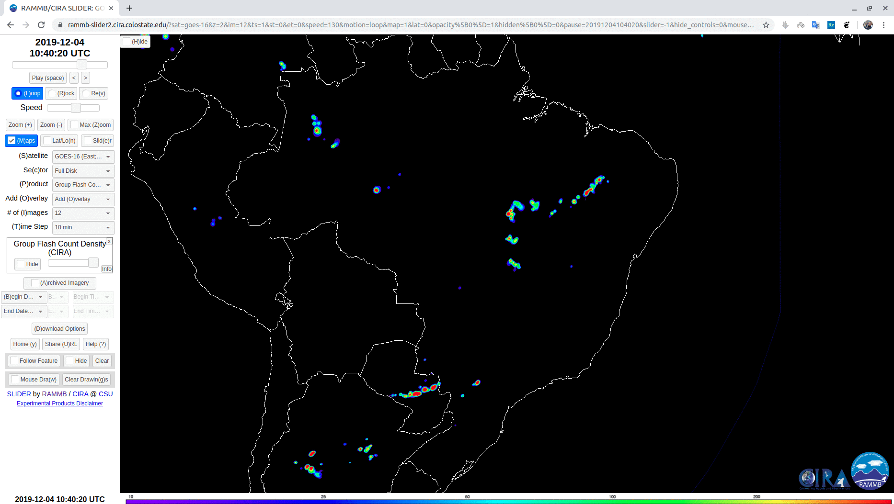
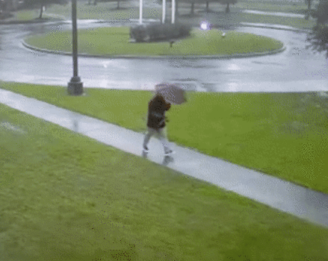
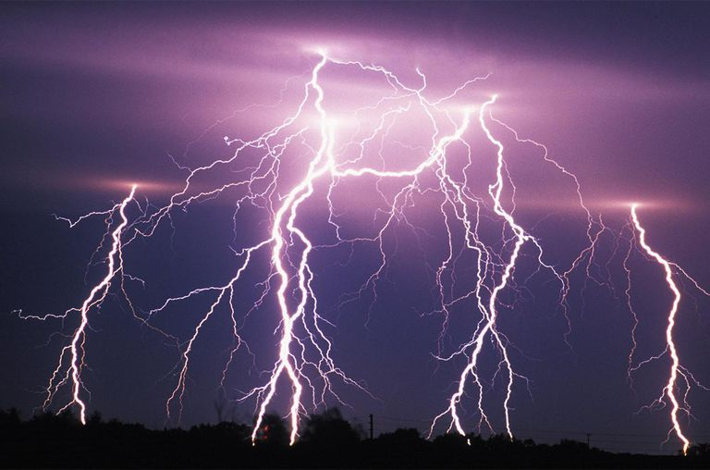
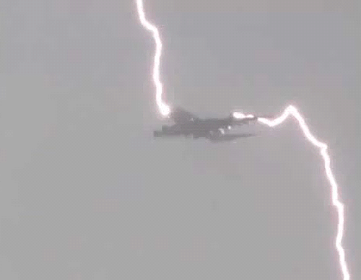
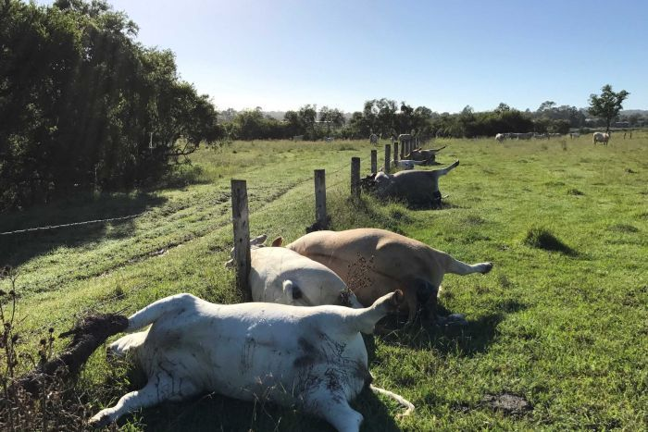
MOTIVATION

Slide 3
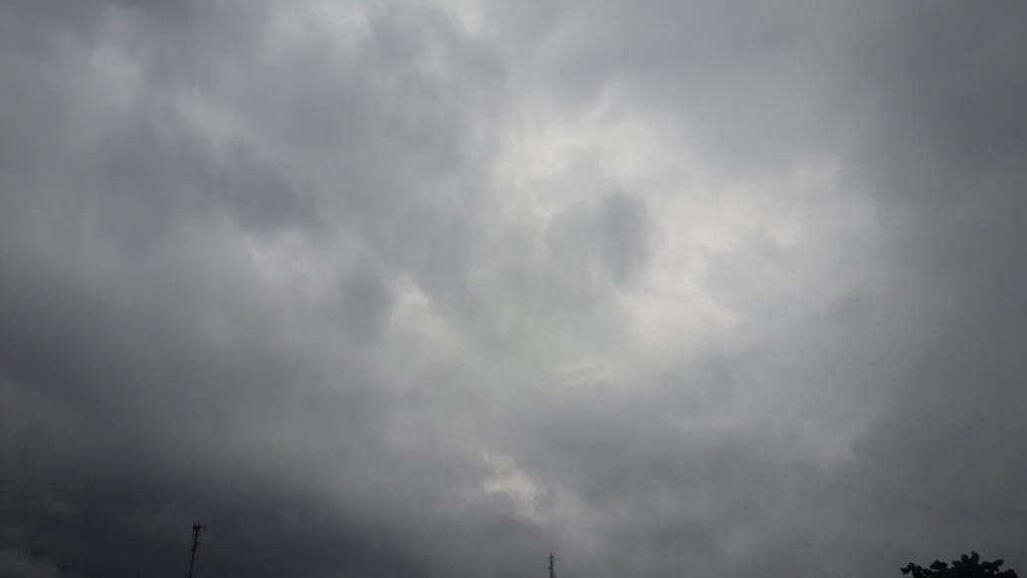
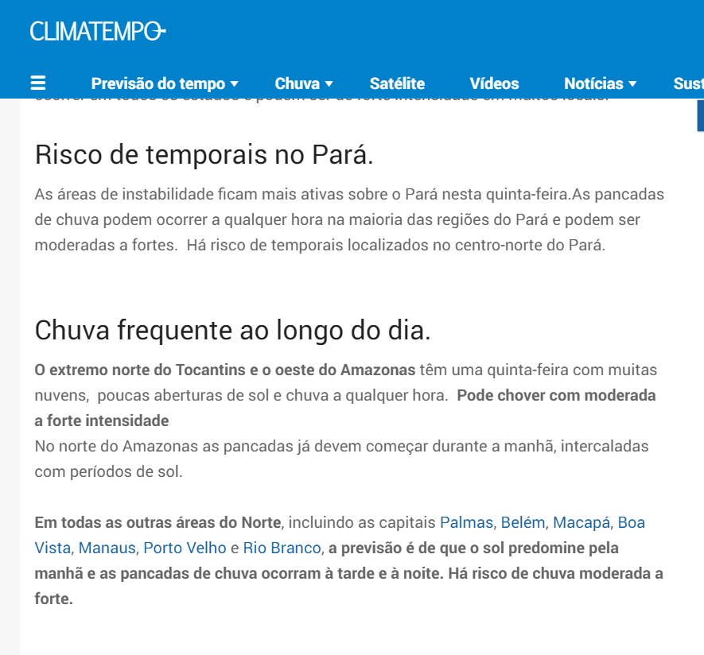
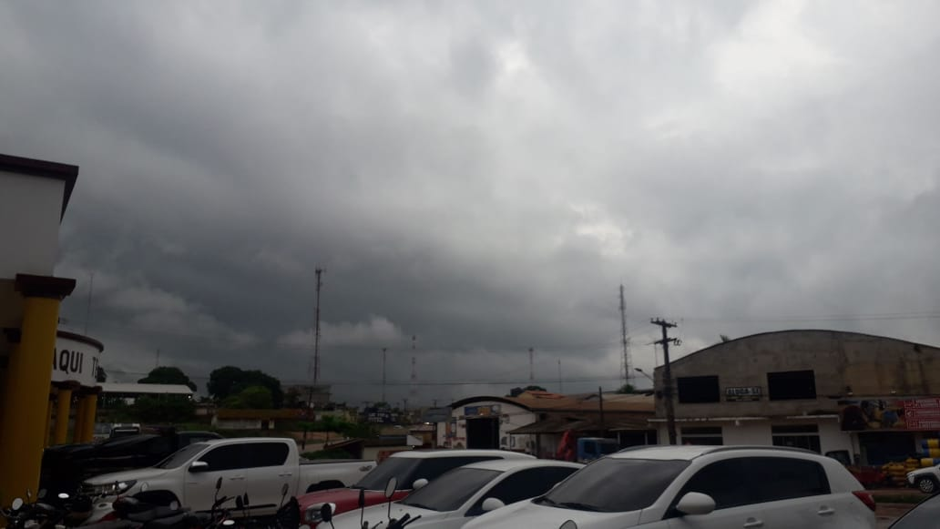
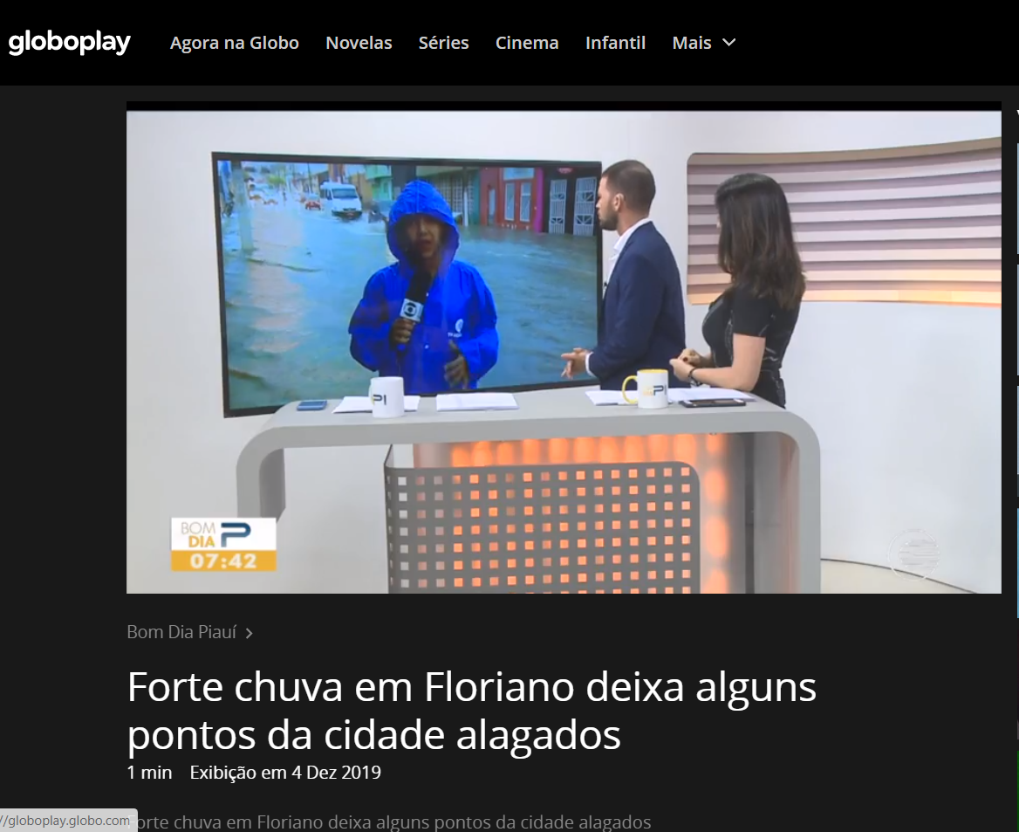
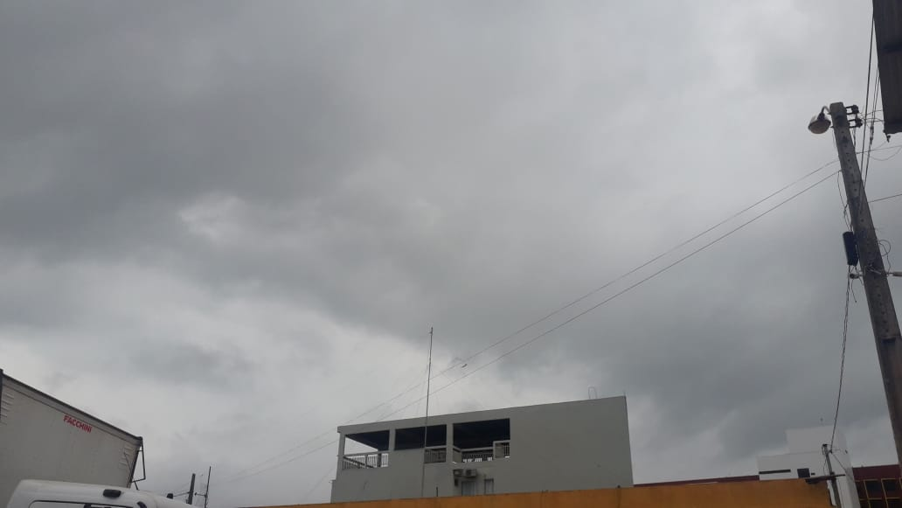
INTRODUCTION

Slide 4
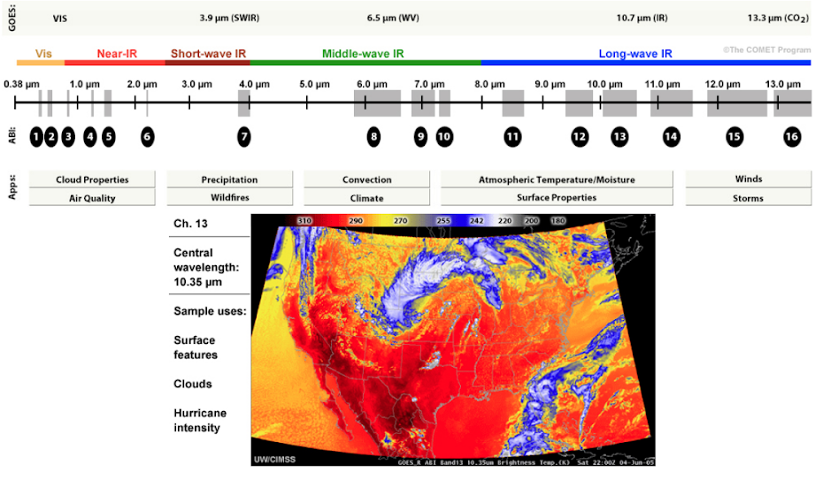
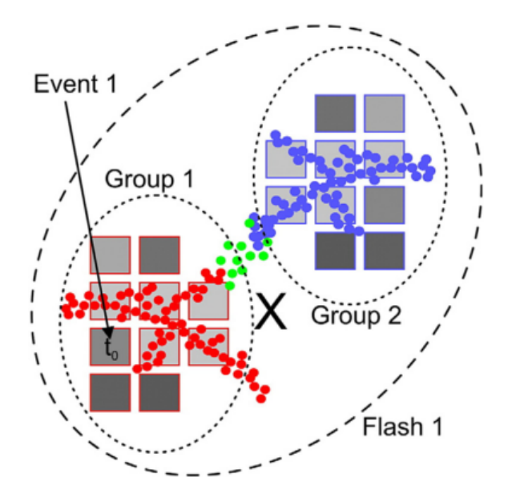
INTRODUCTION

Slide 5

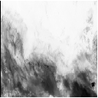
DATA DESCRIPTION (ABI)
NxM
128x128
NetCDF4
Shapefile

Slide 6
DATA DESCRIPTION (GLM)
Time | Long. | Lat. | State
Time 1 | x | y | A
Time 1 | x | x | A
Time 2 | x | x | B
... | ... | ... | ...
Time n | x | x | N
 | A | B | ... | Z
Time 1 | 42 | 299 | 0 | 31
Time 2 | 1 | 1 | 0 | 65
Time 3 | 0 | 1 | 200 | 22
... | ... | ... | ... | ...
Time n | 12 | 1 | 40 | 21
NetCDF4
Shapefile

Slide 7
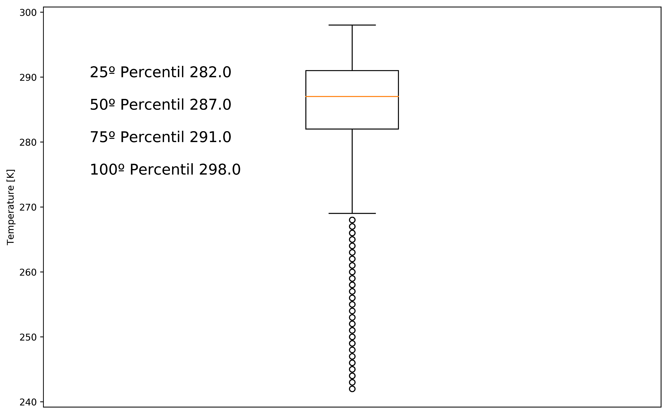
ABI DATA PREPROCESSING
CLASS DEFINITION
Very Cold Cloud
Cold Cloud
Hot Cloud
Very Hot Cloud
INTENSITY
1 | 0 | 0 | 0
0 | 1 | 0 | 0
0 | 0 | 1 | 0
0 | 0 | 0 | 1

Slide 8
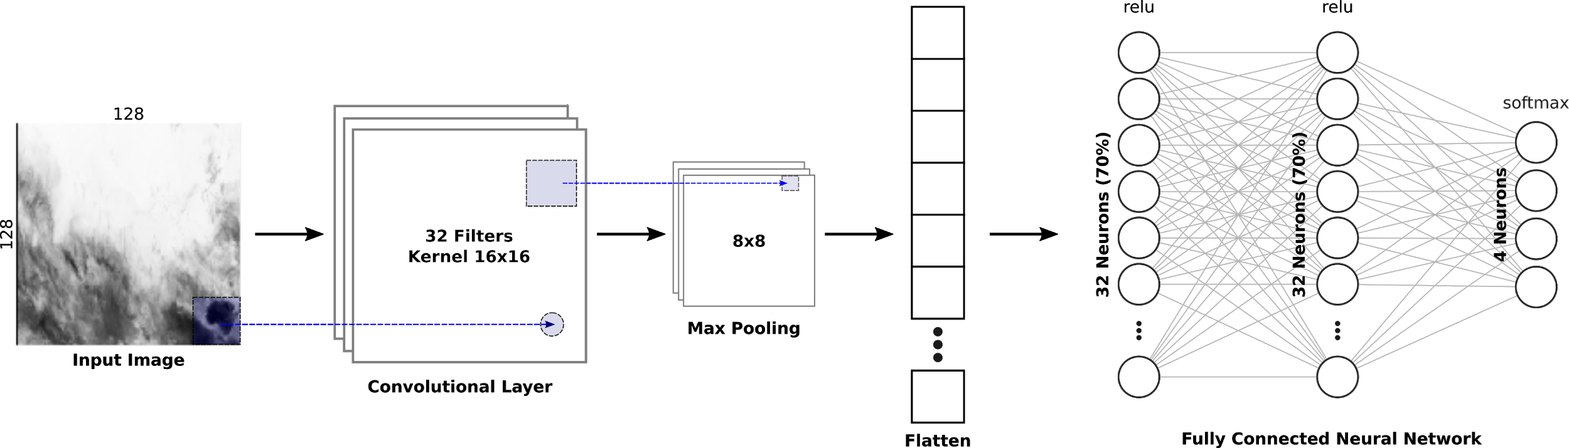
CNN SETUP
Optimezer: ADAM
Loss: Categorical Cross Entropy

Slide 9
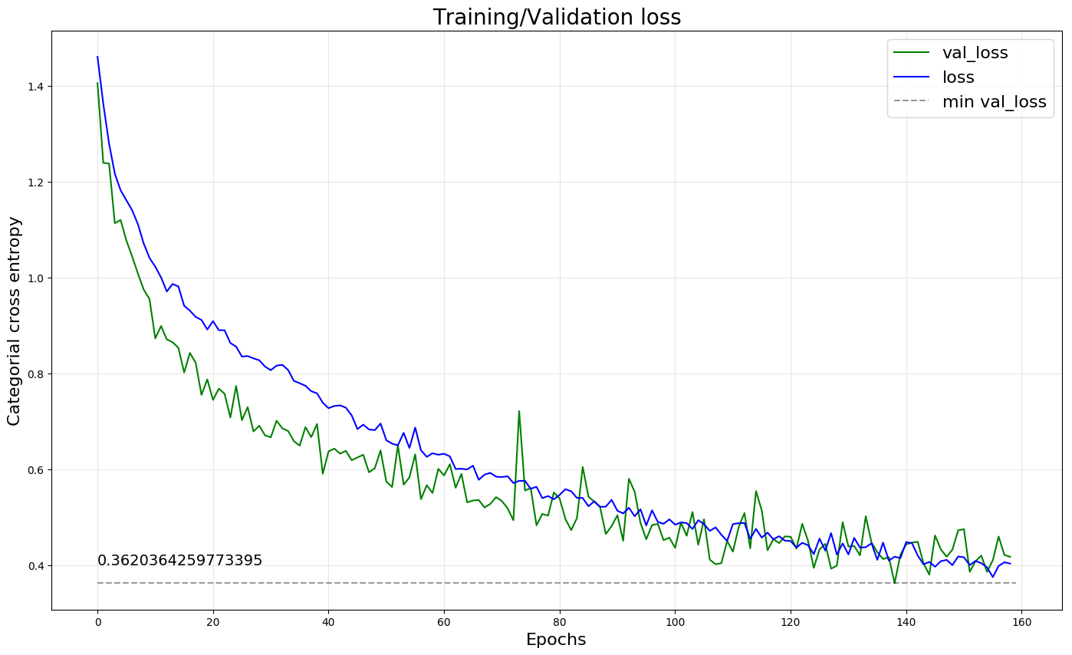
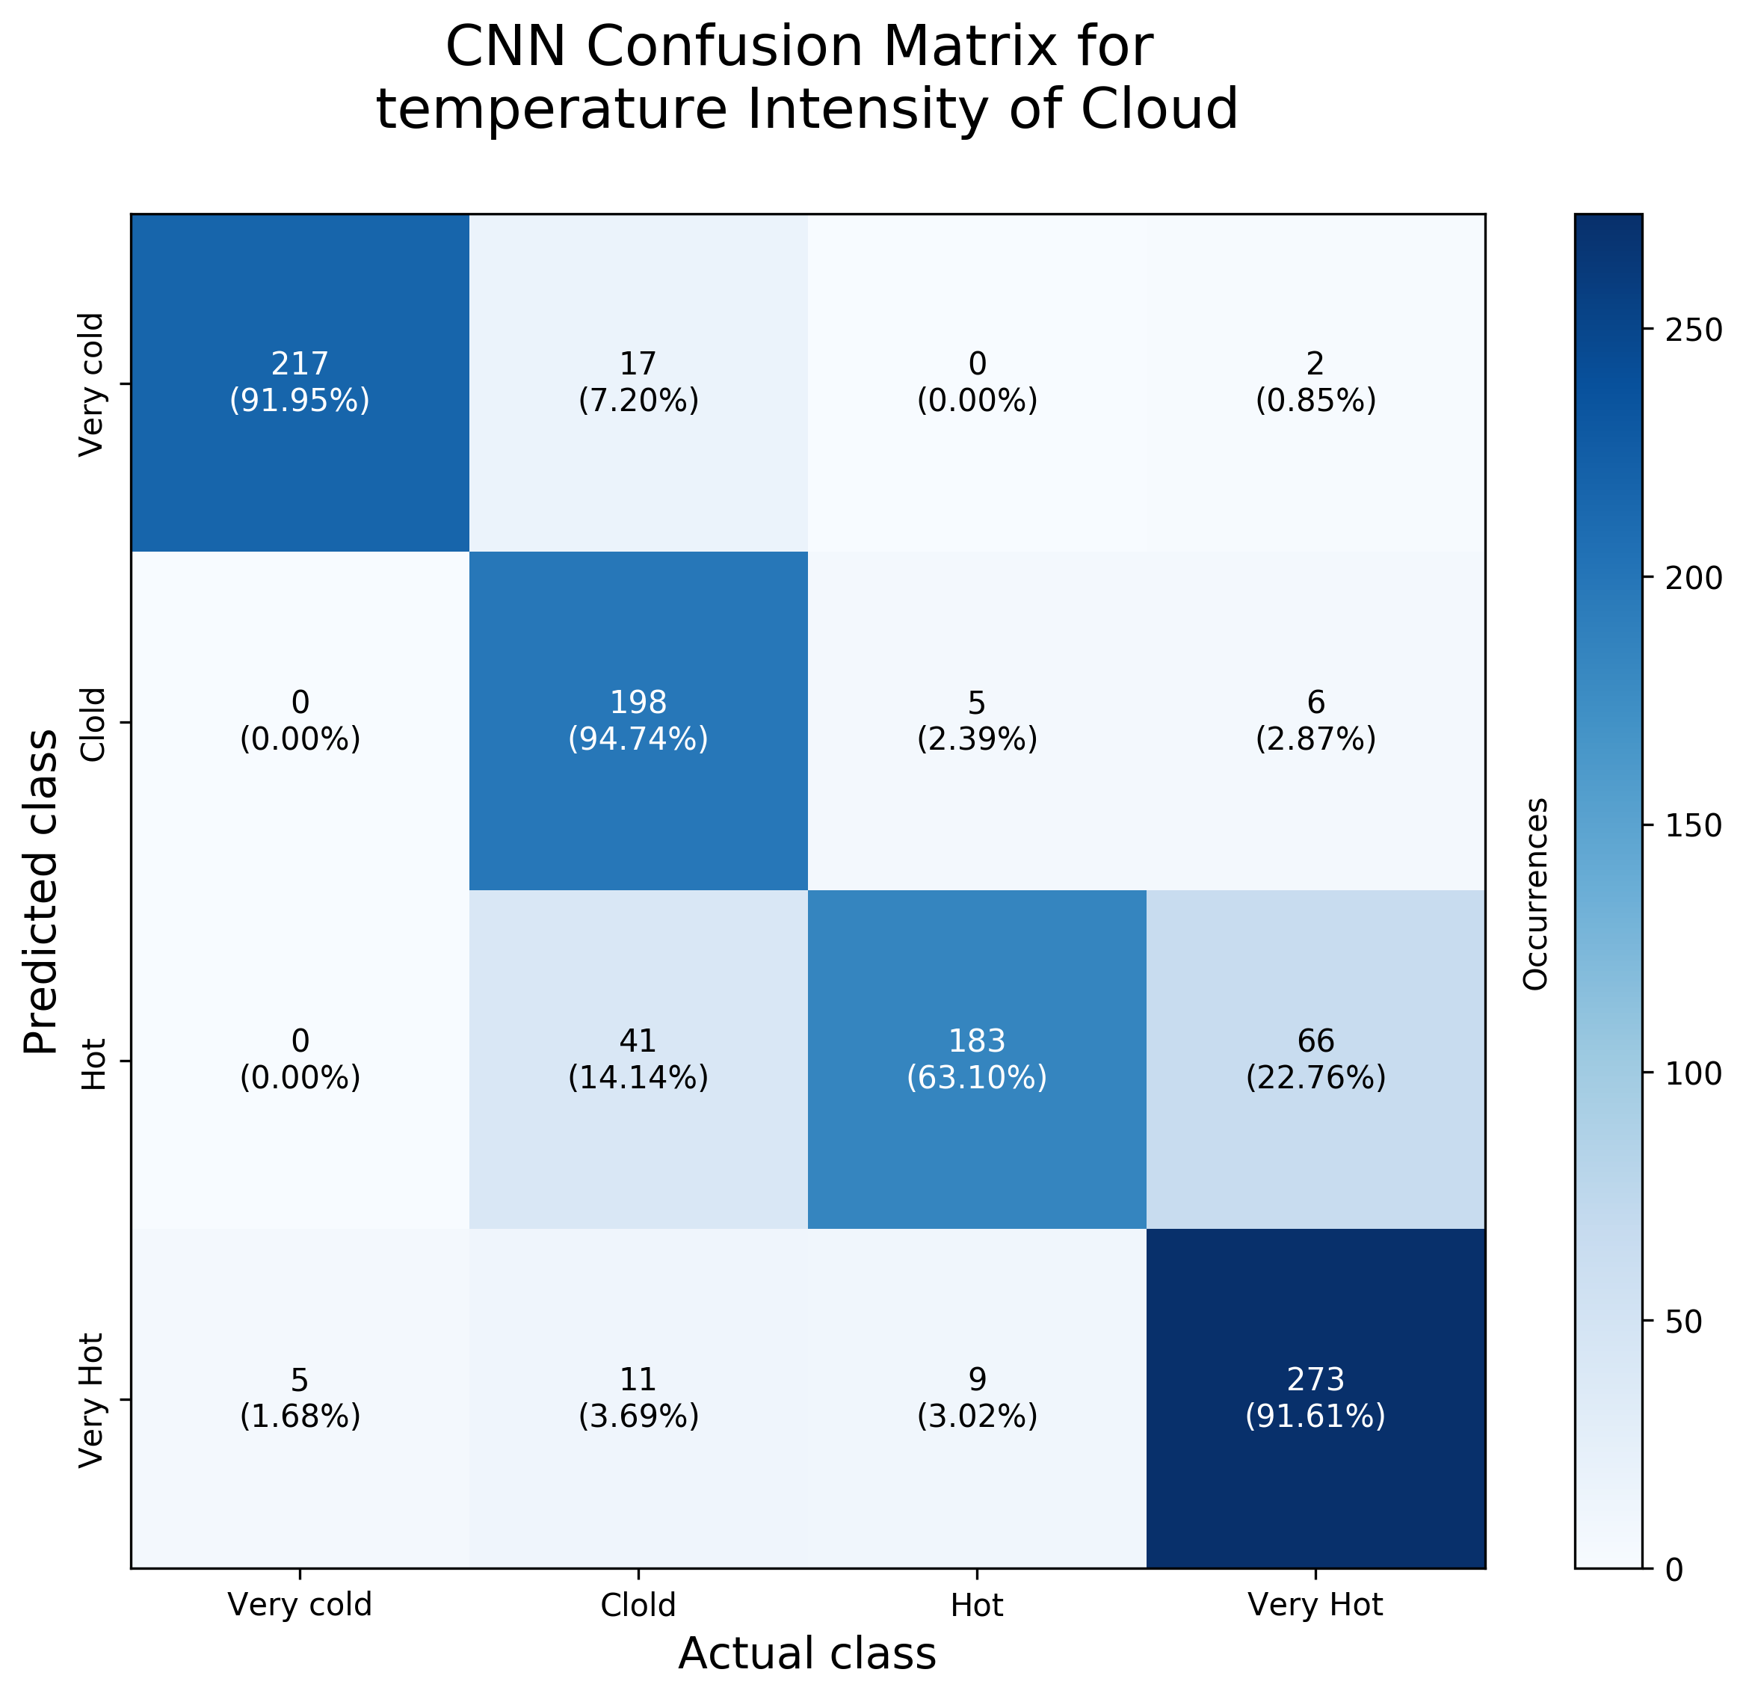
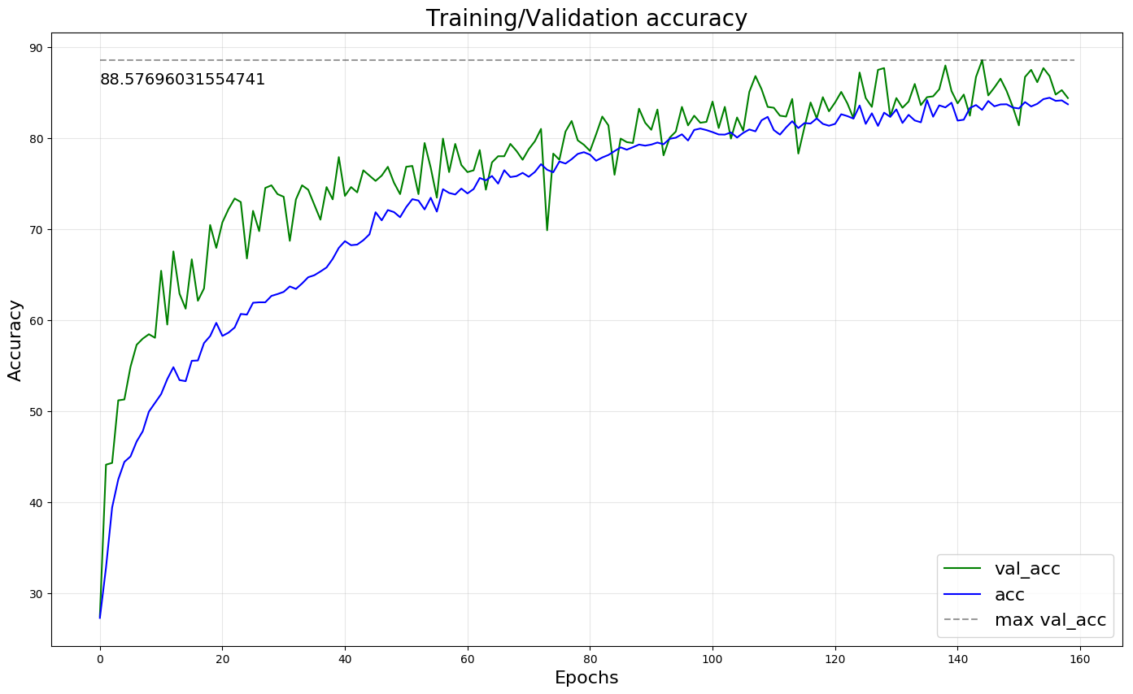
CNN RESULTS

Slide 10
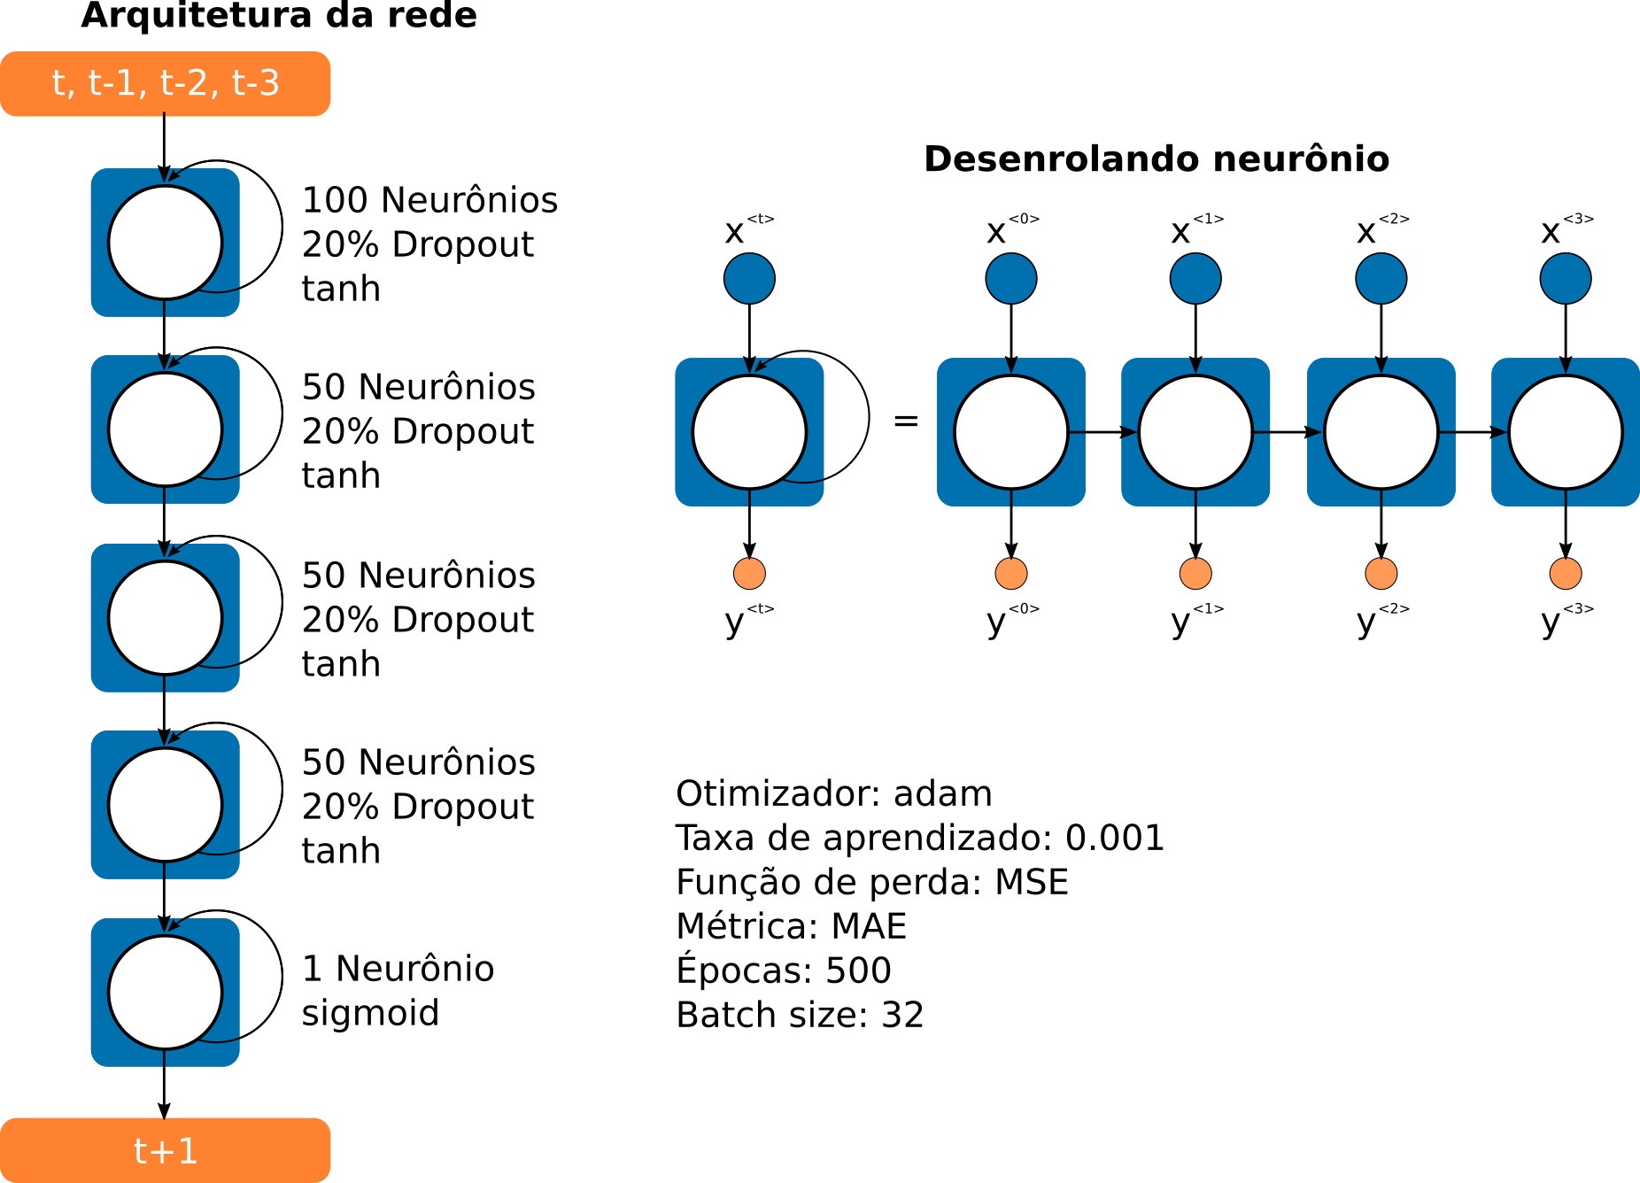
RNN SETUP
Normalized (0, 1)
[T-3, T-2, T-1, T] | T+1
DATA
Train: 255
Test: 40

Slide 11
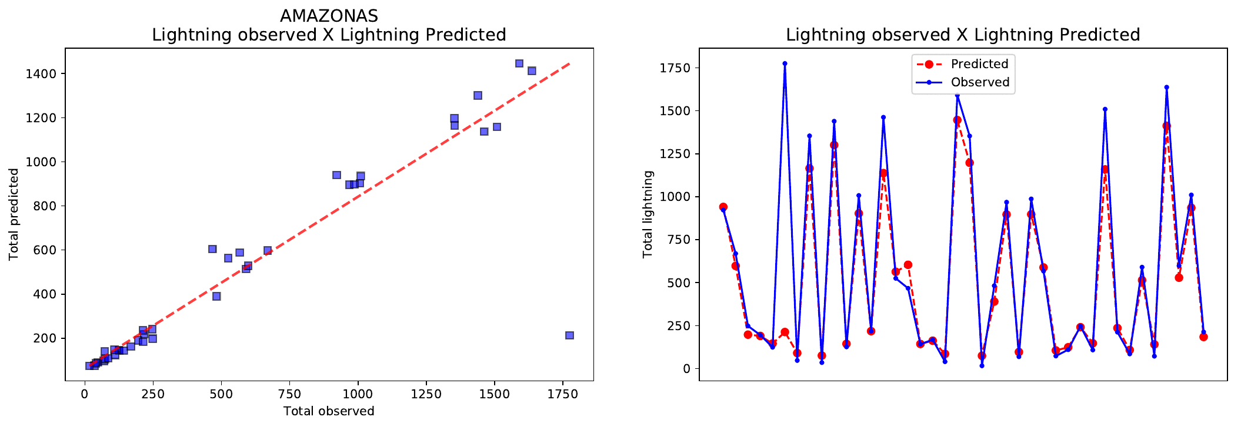
RNN RESULTS

Slide 12
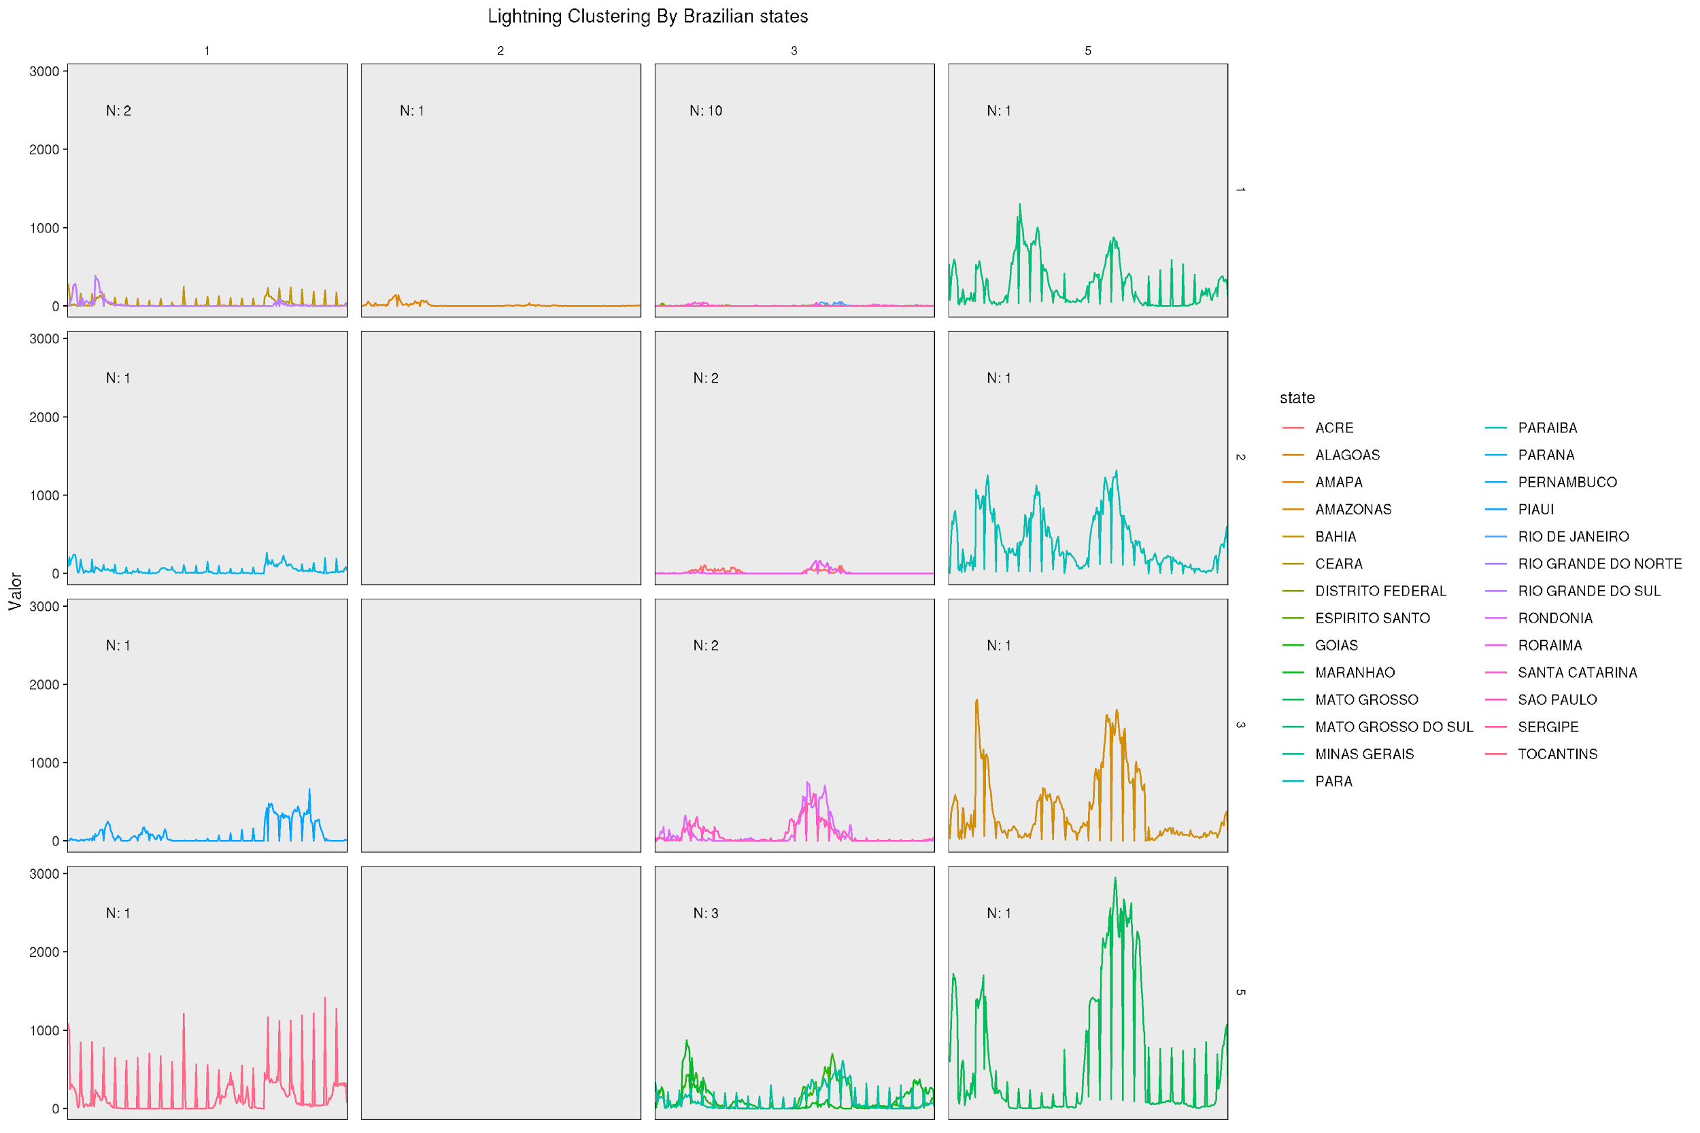
CLUSTERING WITH SOM

Slide 13
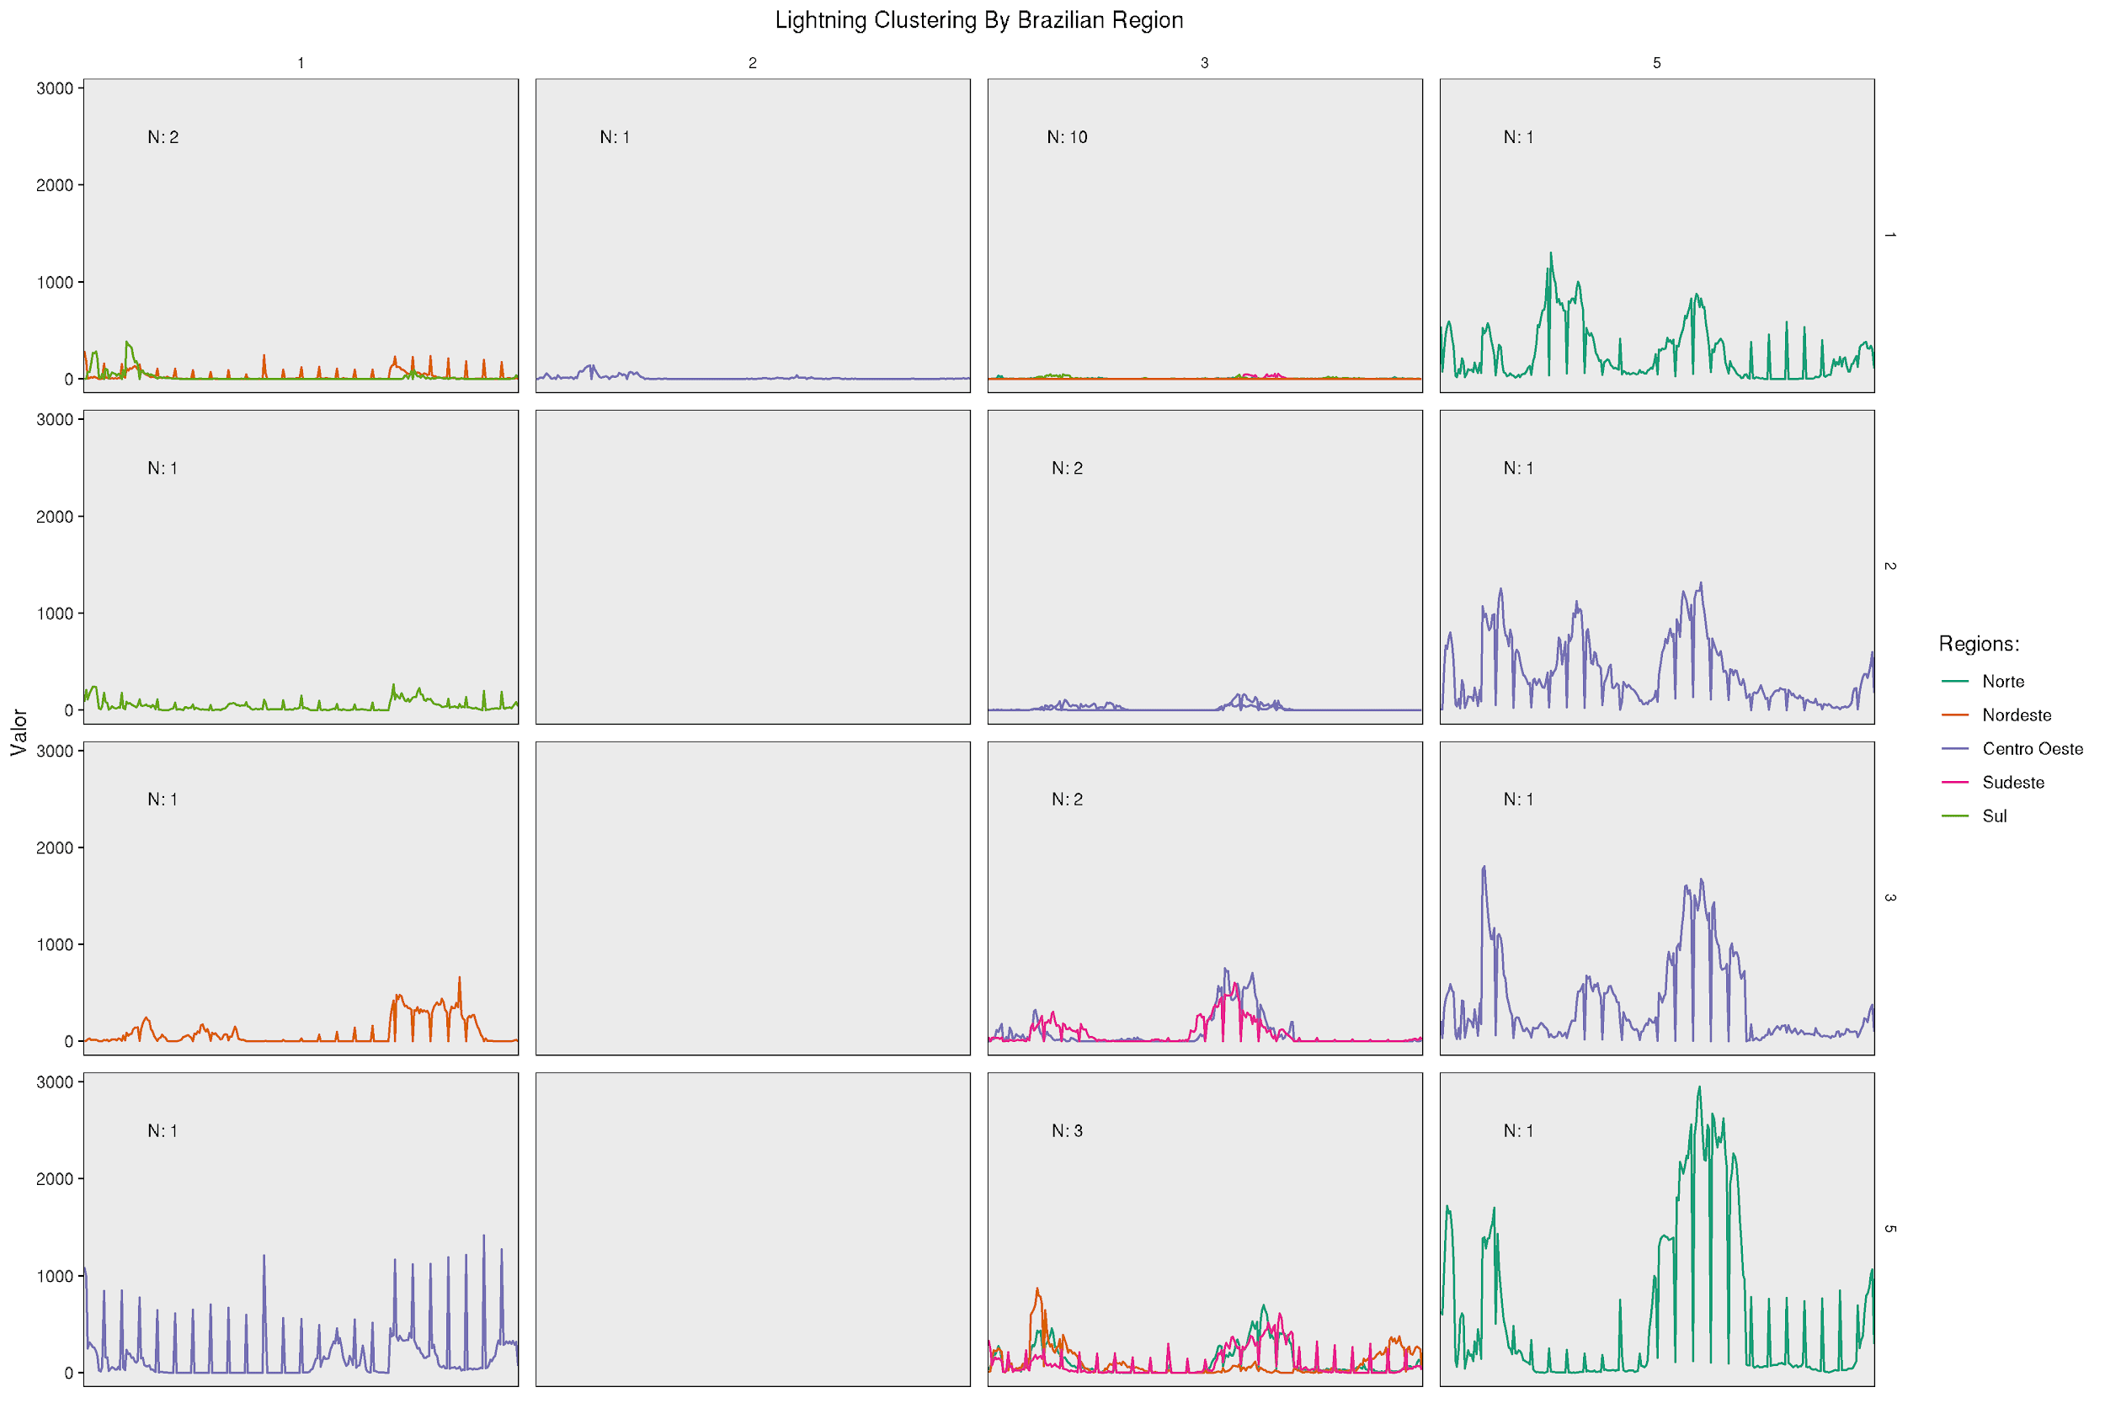
CLUSTERING WITH SOM

Slide 14
BRAZILIAN NATIONAL INSTITUTE FOR SPACE RESEARCH
POST-GRADUATE PROGRAM IN APPLIED COMPUTING
SEVERITY IDENTIFICATION IN MESOSCALE CONVECTIVE SYSTEMS USING RECURRENT AND CONVOLUTIONAL NEURAL NETWORKS
THANKS FOR YOUR ATTENTION
Work presented as a requirement for the CAP- 351 Neuro Computing course taught by Dr. Marcos G. Quiles
Adriano Pereira Almeida
Advised by Alan James Peixoto Calheiros

